Slide 1
REACTJS TRAINING COURSE

Slide 2
0. Agenda
Javascript basics
Why React
First React app
Class & function components
React building blocks
Hooks
Fetching data
Routing
Forms
Styling
testing
Security & login
Redux
tools

Slide 3
1. Javascript basics
Arrow Functions
Classes & Object Literals
Destructuring
Rest/Spread
Template Strings
Promises and Async/Await

Slide 4
2. React - The theory
History
Facebook created React in 2011 for their own use on facebook.com
Facebook open sourced React in 2013.
React ran contrary to popular practices by placing markup and logic together in a single file.
Component‑centric philosophy for separating concerns.
Nowadays many large companies utilize React in production.
Instagram, Netflix, Whatsapp, AirBnb, Uber, Netflix, Twitter, Reddit o Paypal.

Slide 5
2. React - The theory
What Is React?
React is a JavaScript-based UI component development library
Basics
Describe user interfaces using components
Can reuse a single component in multiple user interfaces, and components can contain other components
Have a private state to hold any data that may change over the lifecycle of the component
React will simply react to the changes in a component's state and automatically update the parts of the DOM that need to be updated.
React's component approach lends itself well to building complex Uis by breaking your page down into small, autonomous pieces that you can reason about and test in isolation.
JSX

Slide 6
2. React - The theory
Why React?
Easy creation of dynamic applications
Improved performance
Reusable components
Developer experience & Small learning curve
Flexibility : It can be used for the development of both web and mobile app (Gatsby, Next.js, React Native)
Dedicated tools for easy debugging
Community : https://npmtrends.com/@angular/core-vs-angular-vs-react-vs-vue
React Router, Redux y MobX, Jest, GraphQL, …
Testability
Framework vs. Library
Template-centric vs. JavaScript-centric
Separate vs. Single File

Slide 7
React Getting Started
First react app
Demo React App from scratch
App from create react app
npx create-react-app my-app-name
lab baseline

Slide 8
Class Component vs Function Component
State vs Stateless components
Class components & lifecycle
Class component e lifecycle DEMO

Slide 9
Lists and Keys
Render lists with some type of loop.
map() array method is generally the preferred method
Keys allow React to keep track of elements.

Slide 10
Lab – create a list
Requirements:
List a collection of films
Films object:
id
title
year
genre
director
actors

Slide 11
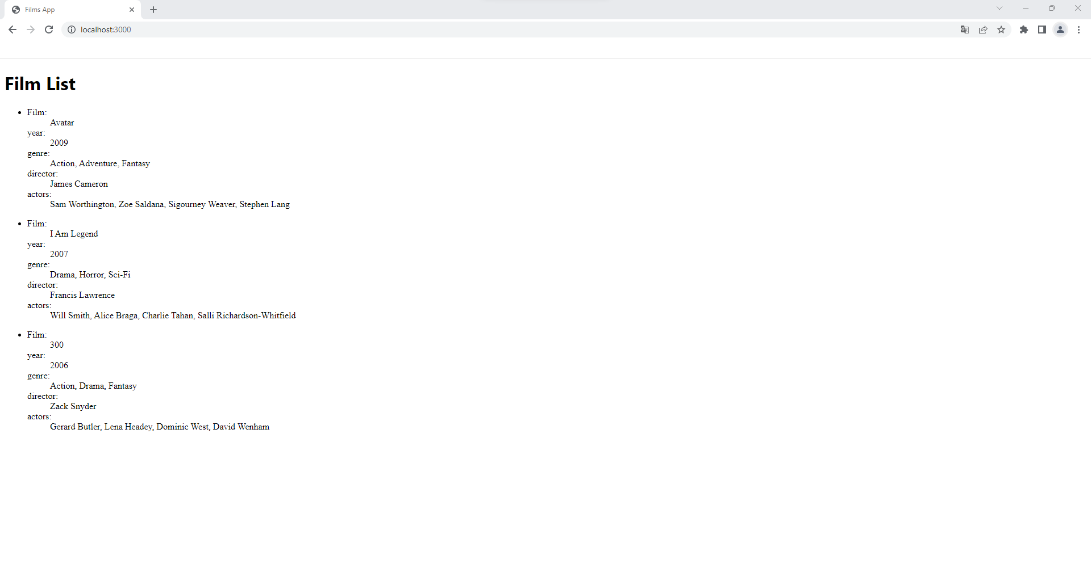
Lab results expected

Slide 12
Composing & Extracting Components
Composing : components can refer to other components in their output.
Extracting : split components into smaller components.

Slide 13
Lab – Components interaction
Requirements
Pass the collection to a component named FilmList. Pass Film content to another component named FilmItem

Slide 14
Lab results expected

Slide 15
Destructuring props
Destructuring it’s a JavaScript feature that allows us to extract multiple pieces of data from an array or object and assign them to their own variables.
Destructuring gives access to the use of props in a more readable format and discards the need for props for every property.
const firstName = person.firstName
const lastName = person.lastName
const city = person.city
const { firstName, lastName, city } = person;

Slide 16
useState
Introduction to hooks
Composition vs Inheritance
Reactive props
useState declaration
Demo: Create an app that display your original name. Create a button that on click change the original name change for a English version of your name.

Slide 17
Lab – Remove item
Requirements
Add a button on each FilmItem that remove the item from the list being displayed
Apply destructuring props

Slide 18
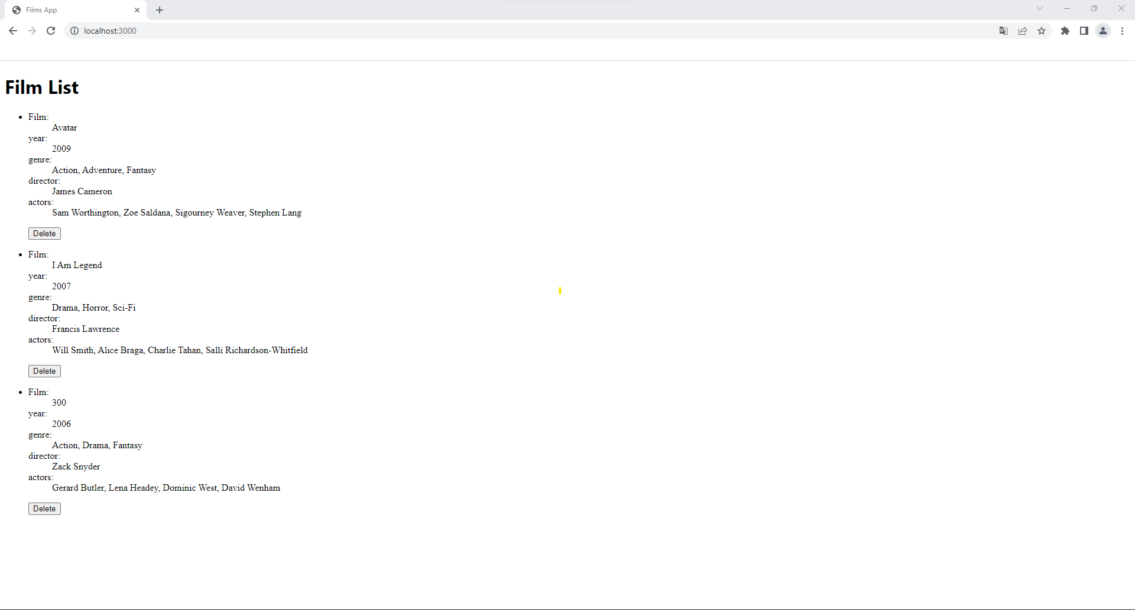
Lab results expected

Slide 19
Using the Effect Hook
Hook that manages side-effects in functional React components.
useEffect will be called after the component renders.
If you do not provide the dependencies array at all and only provide a function to useEffect, it will run after every render.

Slide 20
Fetching Data
Intruduction to api mocha
GET https://apimocha.com/moviesapi/film
GET https://apimocha.com/moviesapi/film/:imdbID
POST https://apimocha.com/moviesapi/film/:imdbID
DELETE https://apimocha.com/moviesapi/film/:imdbID
GET https://apimocha.com/moviesapi/gender
POST https://apimocha.com/authentication/login
Fetch data declaration
Lab:
requirements:
fetch data from API - GET https://apimocha.com/moviesapi/film
display fetched data instead of mocked data
starting branch: movie-app-part-03 | ending branch: movie-app-part-04

Slide 21
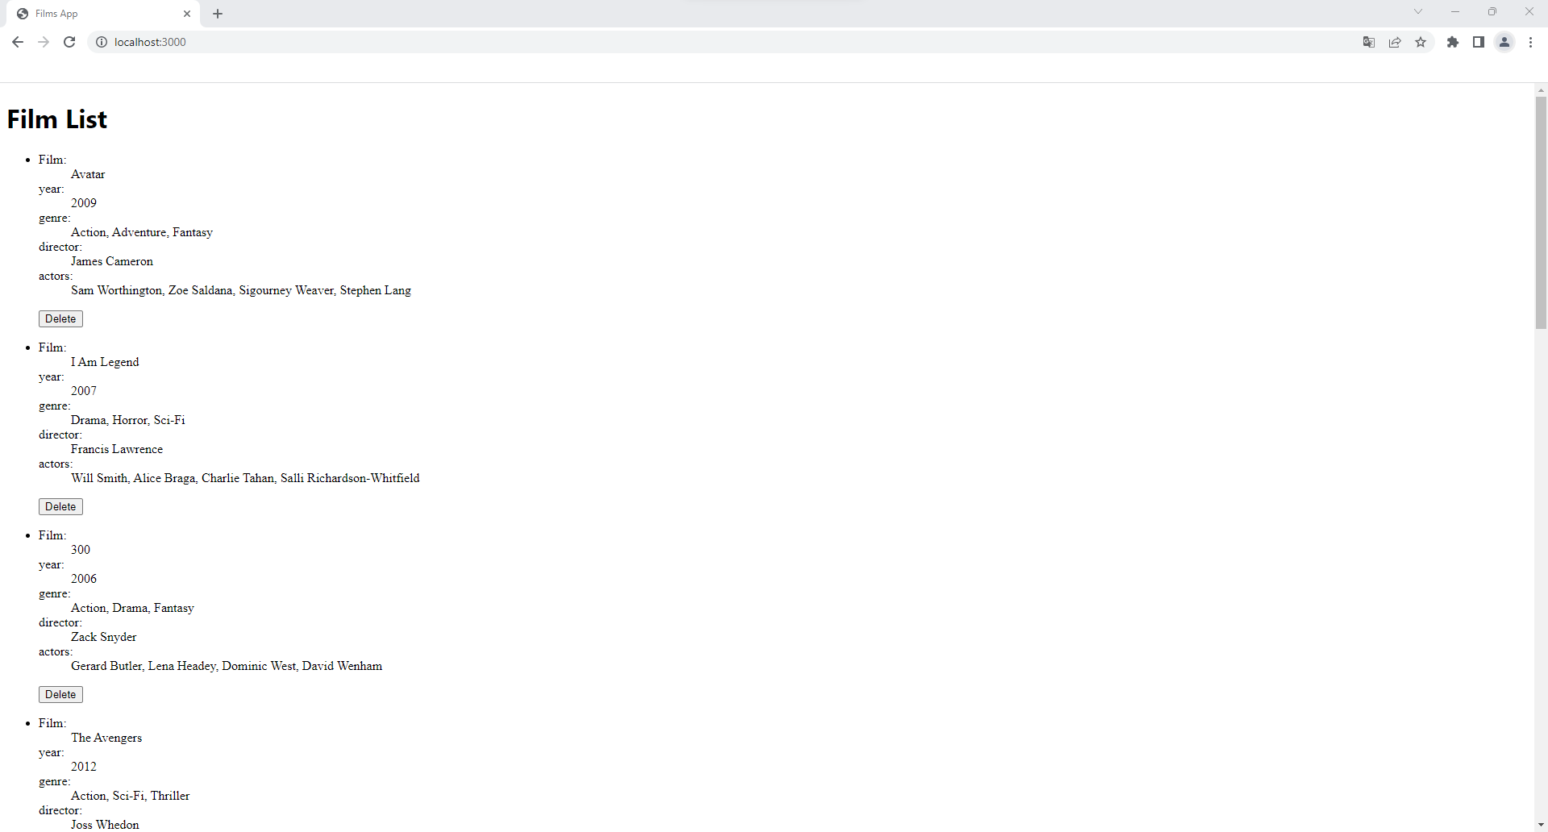
Lab results expected

Slide 22
Challenge LAB: API Post & loading
Requirements
loading while fetching
Update Delete Button to remove from API
Endpoint: DELETE - https://apimocha.com/moviesapi/film/:imdbID
starting branch: movie-app-part-04 |ending branch:movie-app-part-5

Slide 23
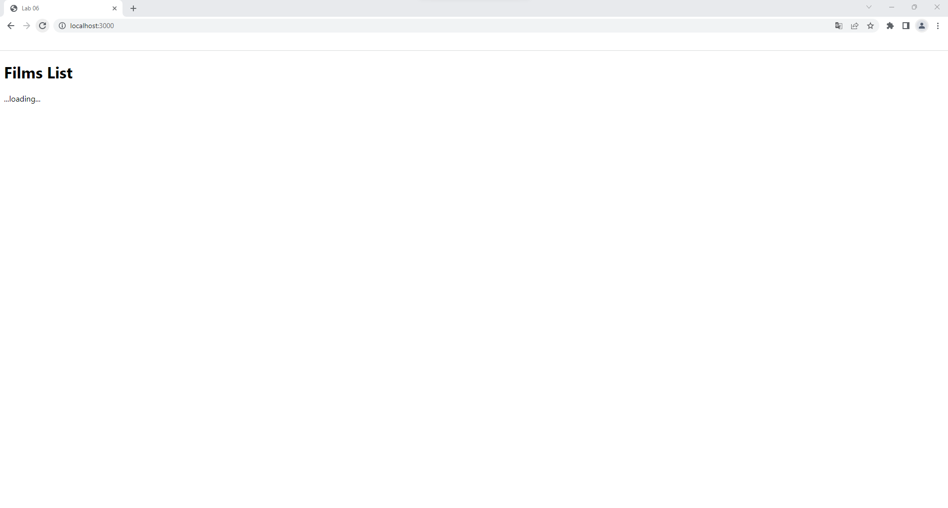
Lab expected results

Slide 24
API handling errors
Handling errors
Response errors
Interact with state properties along response errors
starting branch: movie-app-part-05 | ending branch:movie-app-part-06

Slide 25
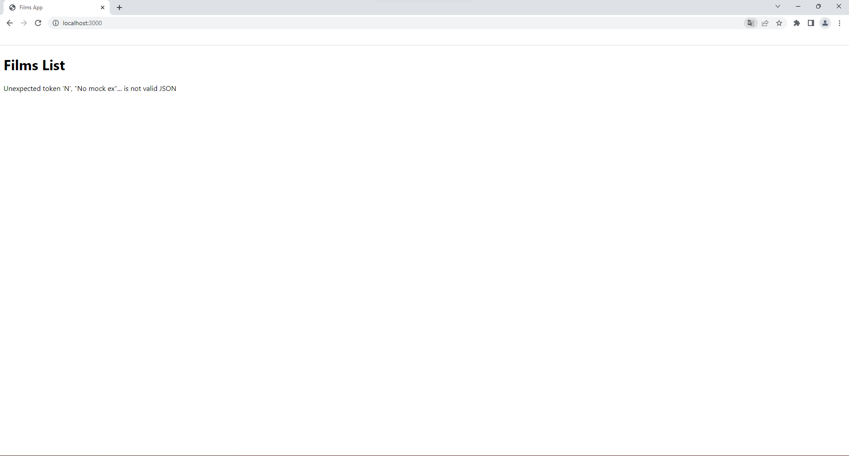
handling errors expected results

Slide 26
Custom hooks
When you have component logic that needs to be used by multiple components, we can extract that logic to a custom Hook.
Custom Hooks start with "use".

Slide 27
Custom hooks Lab
Part 7: API handling errors improved with custom hooks
Requirements
custom hook useFetch
create a hook that with a single url be able to:
Fetch the data
Retrieve it
Control the loading indicator for the fetching process
Handling Errors
starting branch: movie-app-part-06 | ending branch:movie-app-part-07

Slide 28
Movie-app-part-07

Slide 29
Routing - BrowserRoute
Define Routes in App.js
Route match
Create details page
Navigate to URL with params
starting branch: movie-app-part-07 |ending branch:movie-app-part-09

Slide 30
useParams and Link
A <Link> is an element that lets the user navigate to another page by clicking or tapping on it.
The useParams hook returns an object of key/value pairs of the dynamic params from the current URL that were matched by the <Route path>

Slide 31
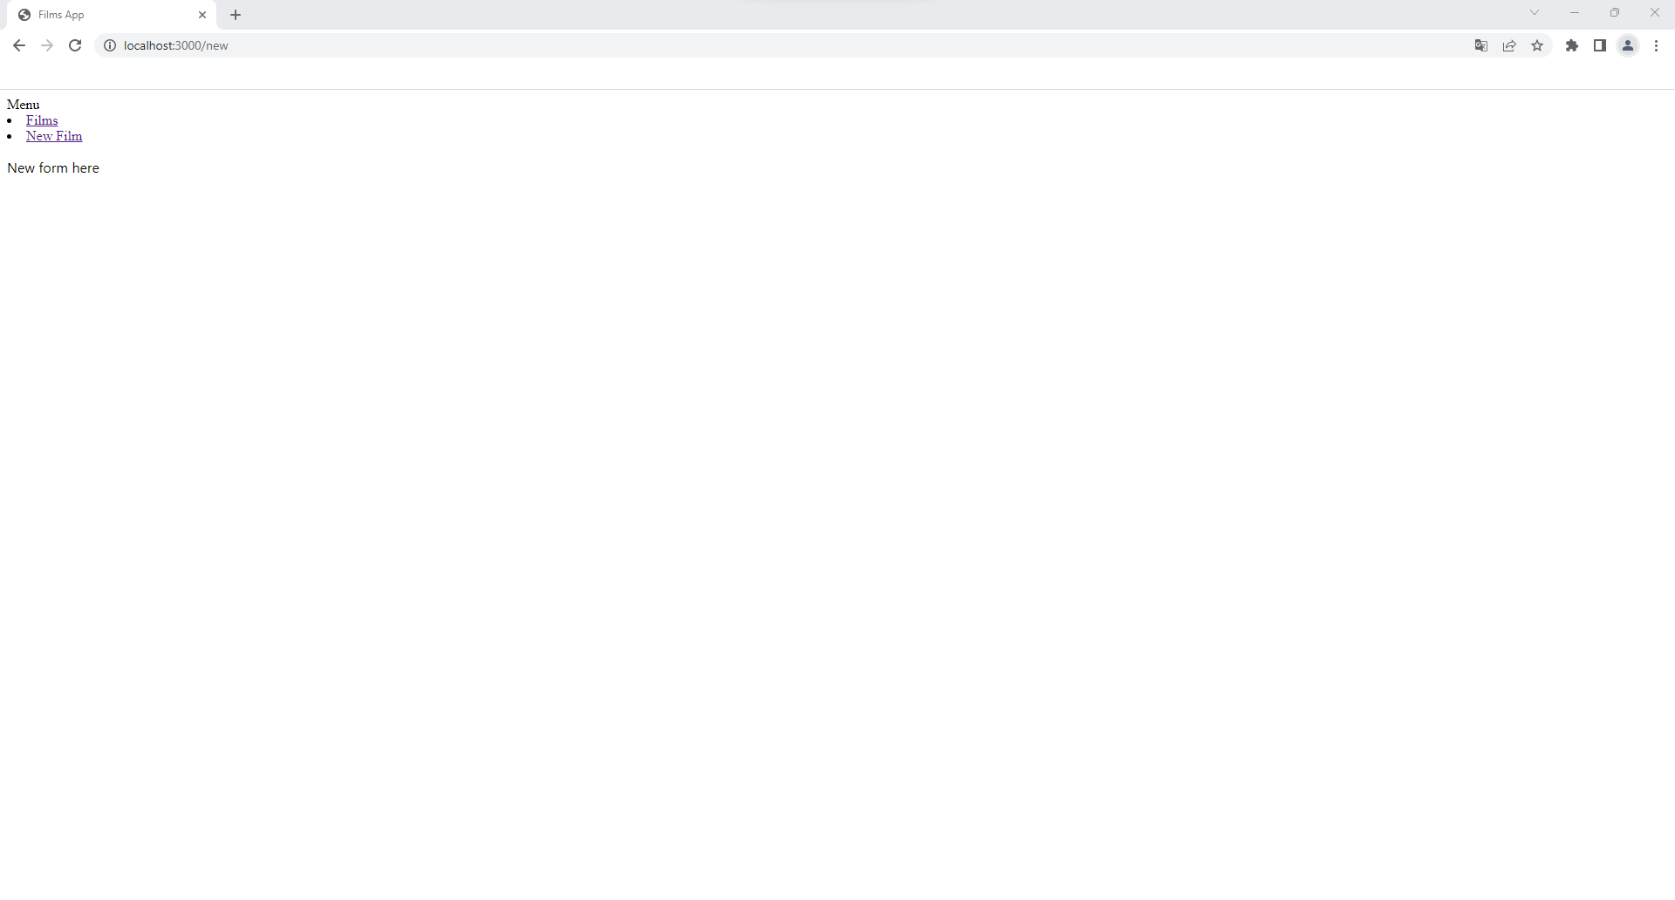
Expected results after Routes definition

Slide 32
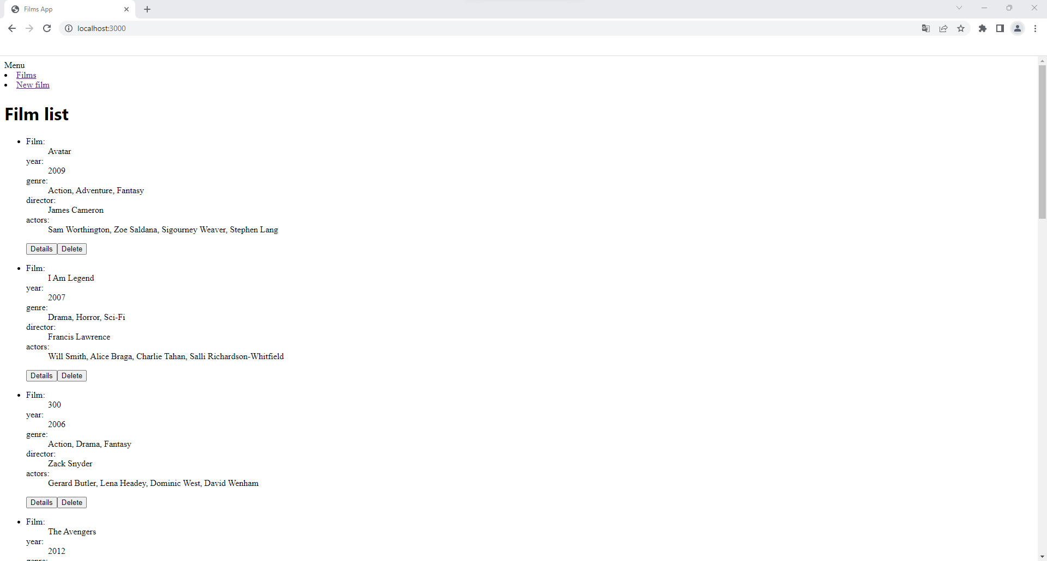
Movie-app-part-09

Slide 33
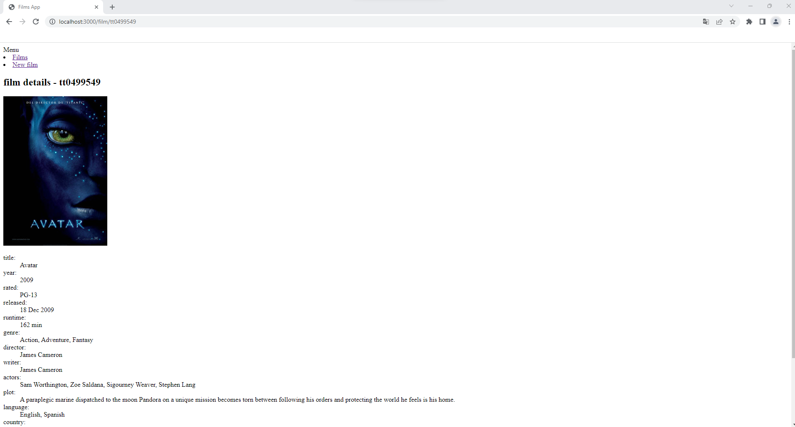
Movie-app-part-9

Slide 34
Forms
Controlled and Uncontrolled components for forms
Custom inputs
Use of alternatives libraries for more advanced forms
Form Validation
First Form Demo
Create new film form in route "/new"
submit form and navigate to home page after creation
const handleSubmit = (e) => {}
POST fetch: https://apimocha.com/moviesapi/film/:imdbID with body
Film object to Post = { imdbID: "", title: "", year: "", gender: "", director: "", actors: "", }
starting branch: movie-app-part-11 | ending branch:movie-app-part-12

Slide 35
Lab - Forms
requirements:
create custom select for gender
fetch All genders using useFetch
Turn gender and actors array values for multi select
All genders endpoint url= "https://apimocha.com/moviesapi/gender"
create a input for actors based on react-select library
npm i react-select for actors
starting branch: movie-app-part-11 | ending branch:movie-app-part-12

Slide 36
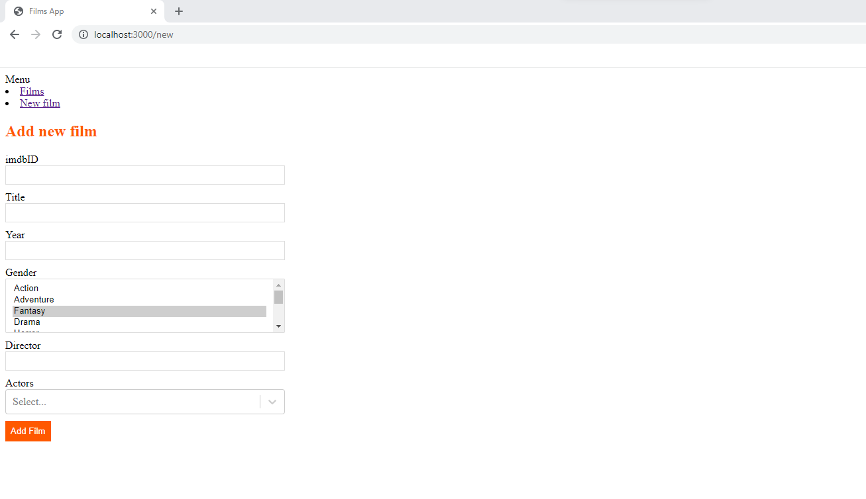
Expected Custom input result

Slide 37
Styling React Components
CSS Stylesheets
You can create a new CSS file in your project directory and add your CSS inside it. You can then import it in your component, class or React JS page.
Inline Styles
Probably the most common and quickest out of all 3 is inline CSS. However it has many disadvantages and it is generally discouraged to use unless it is a very small application. Basically, we create an object that contains different references which are then called using the style{} attribute

Slide 38
Styling React Components
Styted Components
Styled Components lets you write actual CSS in your JavaScript. The main advantage is that you can add conditional code and use variables and functions within the CSS!.
CSS Modules
Can also add scoped styles quite easily, you just need to create a file with the extension .module.css
During the build step a new class was generated dynamically with a unique identifier.
CSS Modules tries to solve a problem that you might encounter when working on medium to large projects and that is global scoping in CSS.

Slide 39
Lab - Styling components
Requirements:
Add Navbar.css -> CSS Stylesheets
Use Inline Styles in FilmItem.js
Add FilmDetails.module.css -> CSS Modules
Use Styled Components in FilmList.js
starting branch: movie-app-part-09 | ending branch:movie-app-part-10

Slide 40
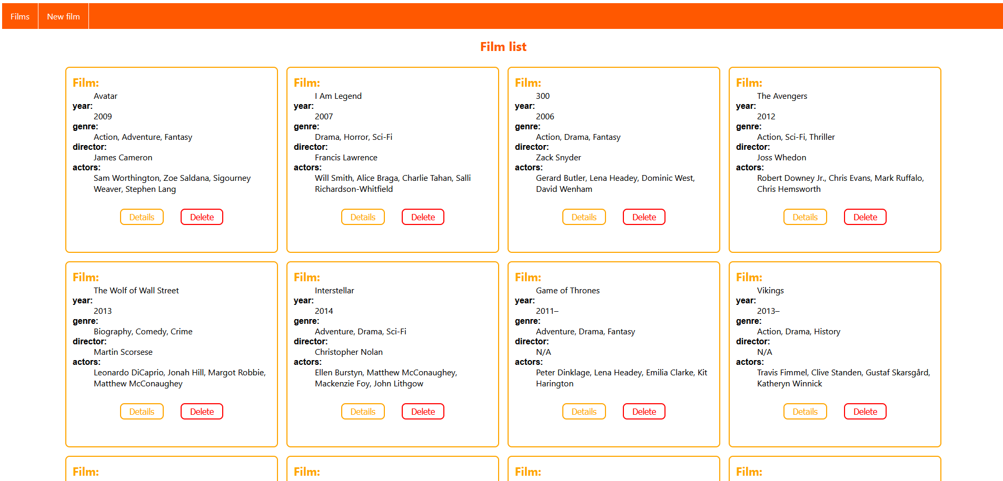
Movie-app-part-10

Slide 41
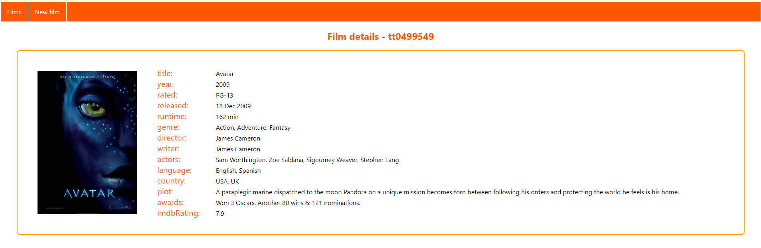
Movie-app-part-10

Slide 42
Testing
React Testing Library
npm install --save-dev @testing-library/react
npm install --save-dev @testing-library/jest-dom
It provides utility functions for better testing practices.
It's not a test runner or framework
Jest
npm install --save-dev jest
Test Runner / Framework

Slide 43
Lab - Testing
Requirements
App.test.js 1. Check component rendering after navigation to form (using click and timeout). Using getByText method.
FilmItem.test.js 2. Check component rendering using mock for props. Using getByText method.
Navbar.test.js : 3. Testing using getByRole from React Testing Library
starting branch: movie-app-part-14 | ending branch:movie-app-part-15

Slide 44
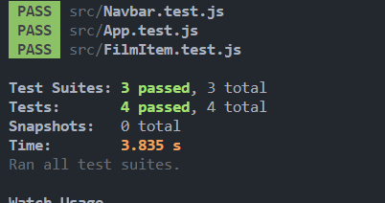
Movie-app-part-15

Slide 45
Context API
Context is designed to share data that can be considered “global” for a tree of React components.
i.e: Authenticated user, theme, or preferred language
Used when some data needs to be accessible by many components at different nesting levels.
Consumer & Provider

Slide 46
Lab – Context API
Requirements
Create ThemeContext : dark - light (updated in Navbar.js)

Slide 47
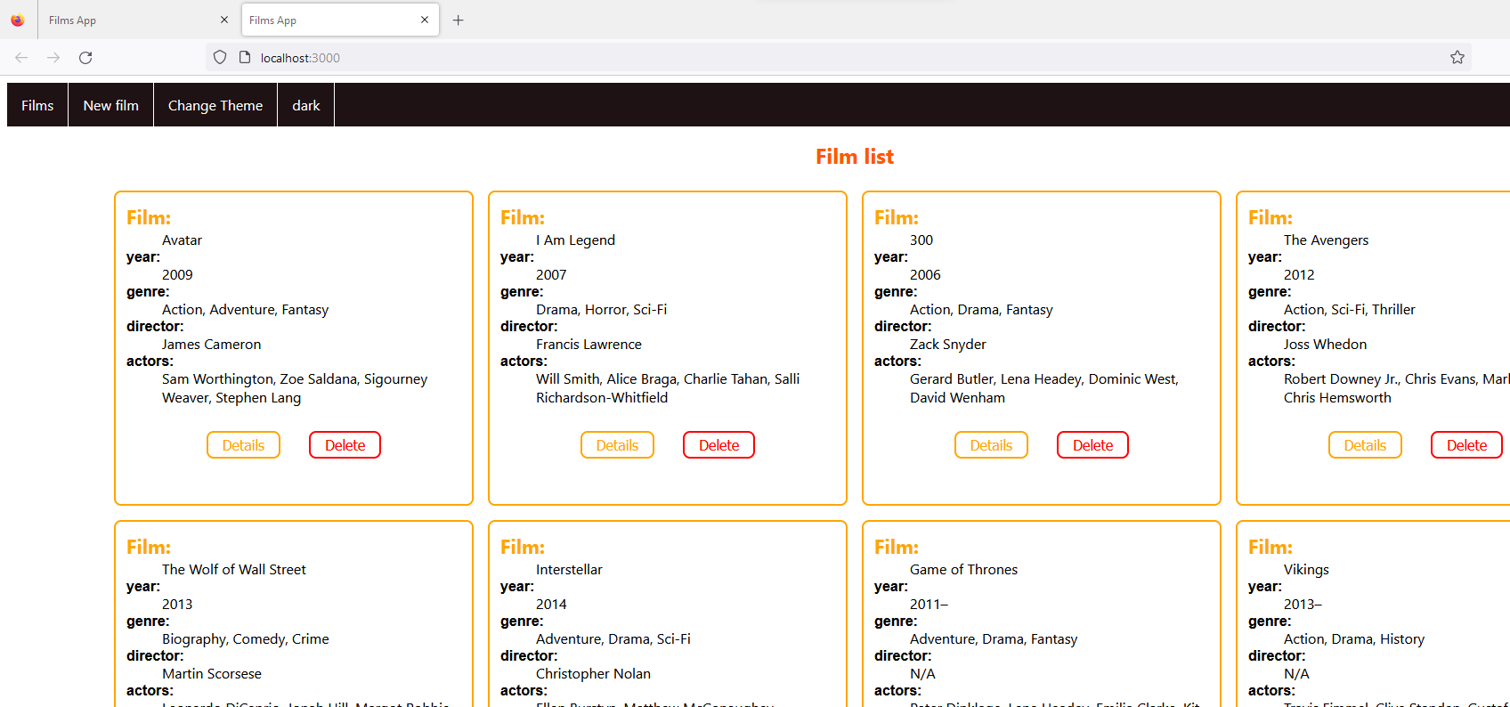
Movie-app-part-16

Slide 48
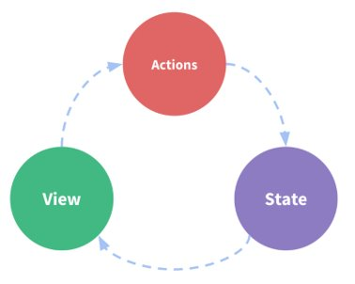
Redux
State - source of truth
View – Display current state
Actions – events triggered by user input that make state to change
One-way data flow
Lifting state up mess
Immutability – chain of state history
Time Travel debugging
Reducer – function that receive current state and an
Action and decides how to update the state.
Check if the reducer cares about this action
If yes, make a copy with updated state
and return it
Store - the current Redux application state (object)
store.GetState()
Store.dispatch(...) The only way to update the state is to call store.dispatch() and pass in an action object. - the triggering an event
Selectors
Reducer update state
Dispatch(action)
Selectors

Slide 49
Redux
The UI dispatches an action
The store runs the reducers, and the state is updated based on what occurred
The store notifies the UI that the state has changed
The UI re-renders based on the new state

Slide 50
Lab - Redux
Requirements
Configure store
- Create watchlistReducer with 2 actions : DELETE_FILM and ADD_FILM
Create new file WatchList.js (displays movies from Redux state)
Provide capability to delete each item in watchlist calling the dispatch for deletion
Add button "To WatchList" in FilmList component that uses dispatch for addition from Redux.
Cheating code : https://github.com/reactjs-essentials/training-content/tree/main/lab-redux-solution
Redux reference: https://redux.js.org/tutorials/essentials/part-1-overview-concepts
Redux DevTools : https://chrome.google.com/webstore/detail/redux-devtools/lmhkpmbekcpmknklioeibfkpmmfibljd?hl=en
starting branch: movie-app-part-16 | ending branch:movie-app-part-17

Slide 51
Movie-app-part-17
Part 17: Redux
Requirements
Create new file WatchList.js (displays movies from Redux state)
Add button WatchList in FilmList component that uses dispatch function from Redux.
Create watchlistReducer with 2 actions : DELETE_FILM and ADD_FILM

Slide 52
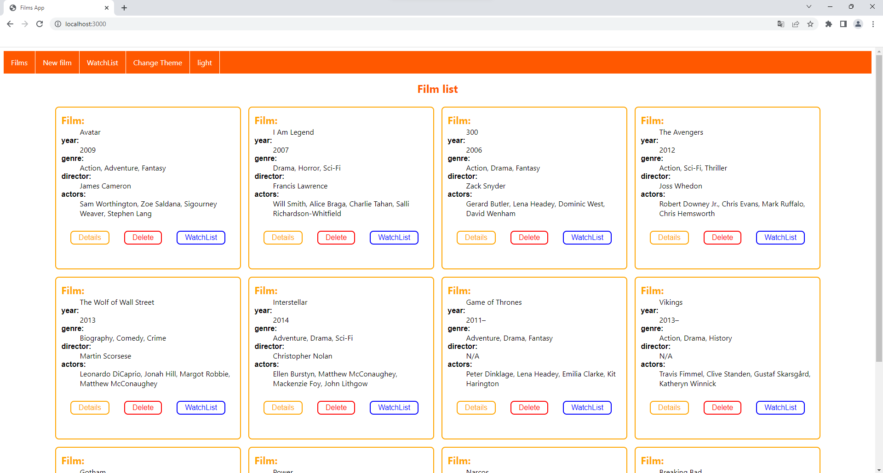
Movie-app-part-17

Slide 53
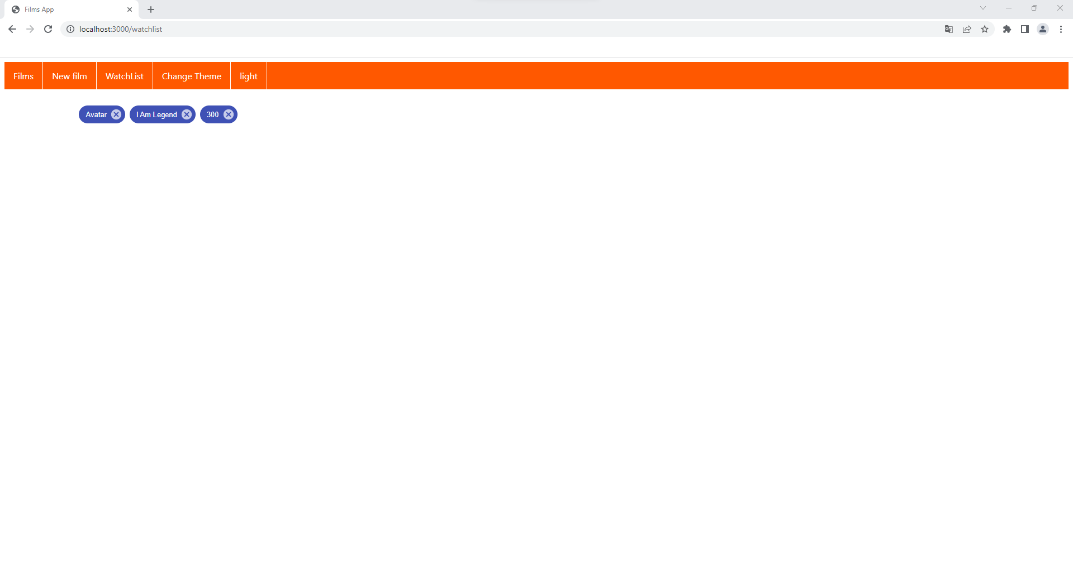
Movie-app-part-17

Slide 54
Authentication and Authorization

Slide 55
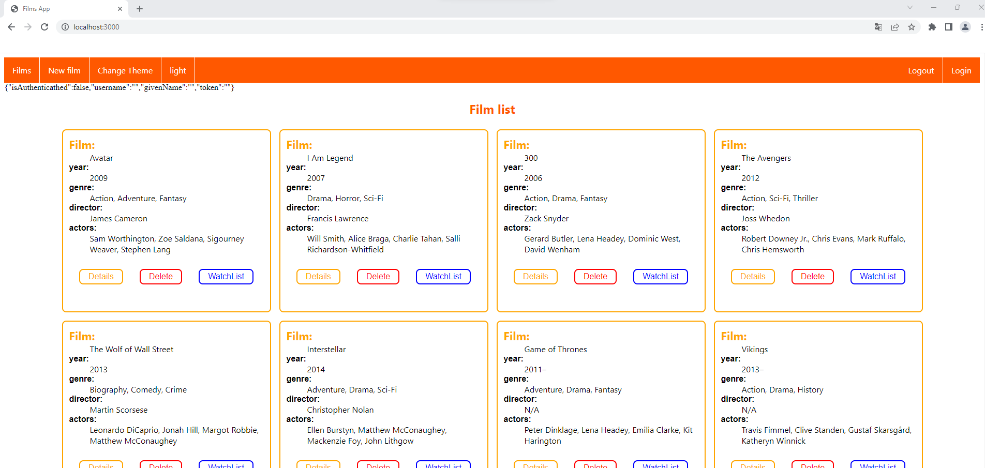
Movie-app-part-18

